Slide 1


IoT Security: Problems, Challenges and Solutions
Dr. Gaurav Bansod
Department of Electronics and Telecommunications
Pune Institute of Computer Technology, Pune,
Maharashtra, India.

Slide 2
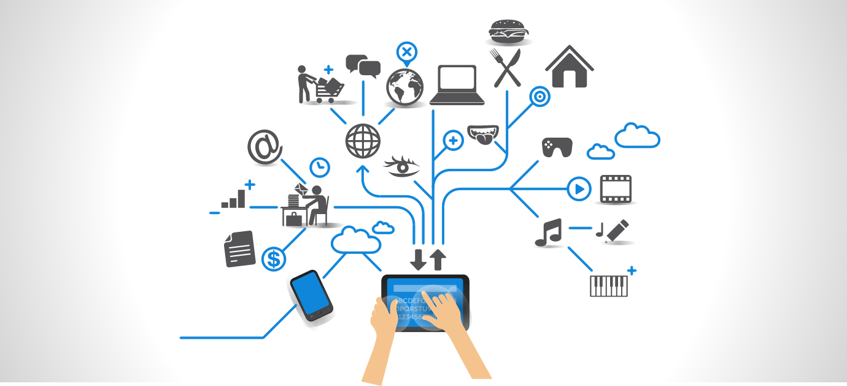
Internet of Things

Slide 3
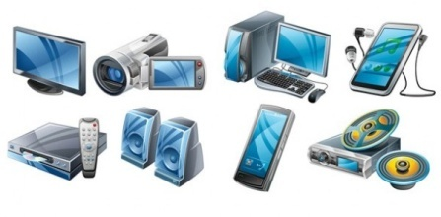
Current and Future Trends
Things
50 billion
Digital Society Sustainable world
Personal Mobile
Inflection Points
Inflection Points
People
5 billion
Global Connectivity
Sites
1 billion
1900 1925 1950 1975 2000 2025

Slide 4
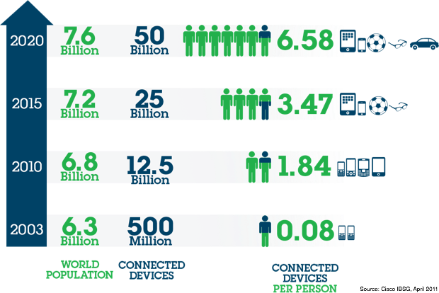
Current and Future Trends

Slide 5
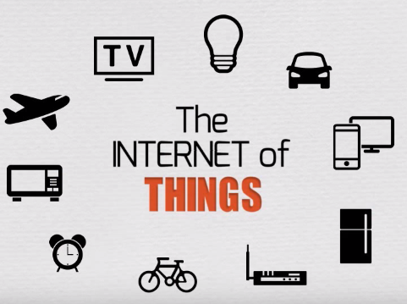
IoT

Slide 6
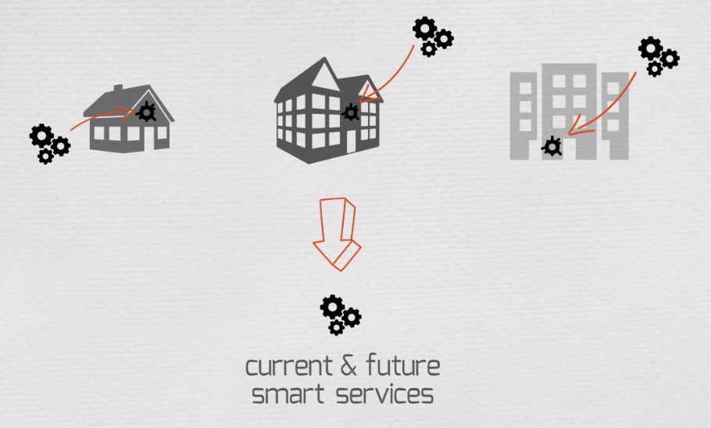
IoT

Slide 7
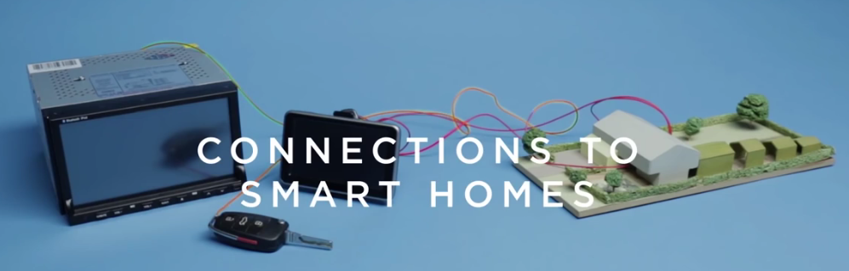
IoT
Single System
For Multiple system such type of many systems are connected to network
So there is the problem of data storage and security

Slide 8

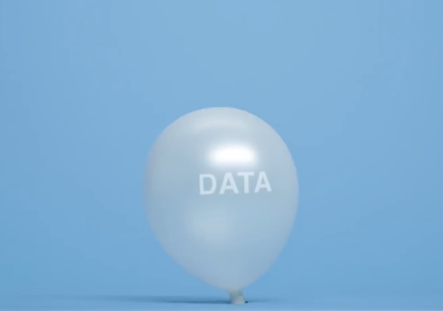

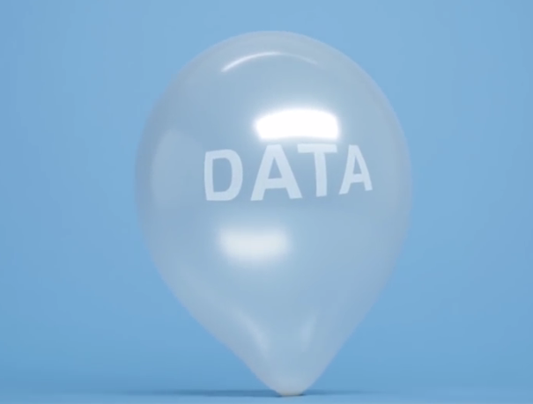
Data on Cloud
Data Leak (Blast)

Slide 9
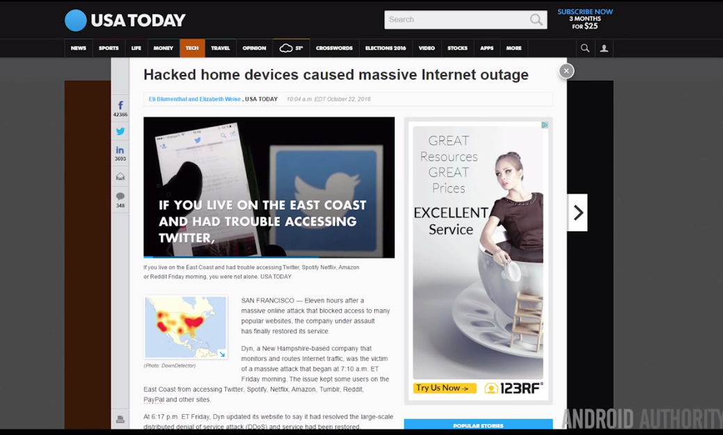
Recent Problems

Slide 10
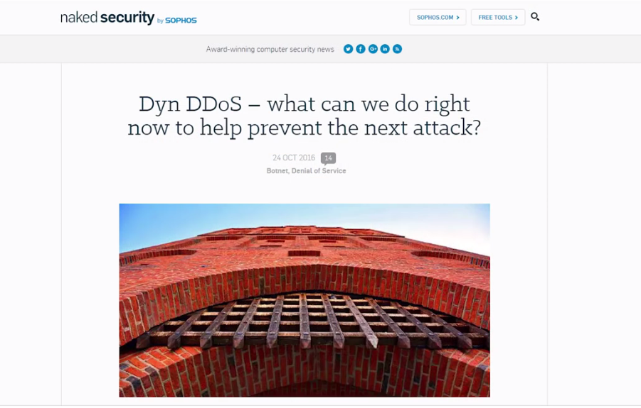
Denial of Service Attack

Slide 11
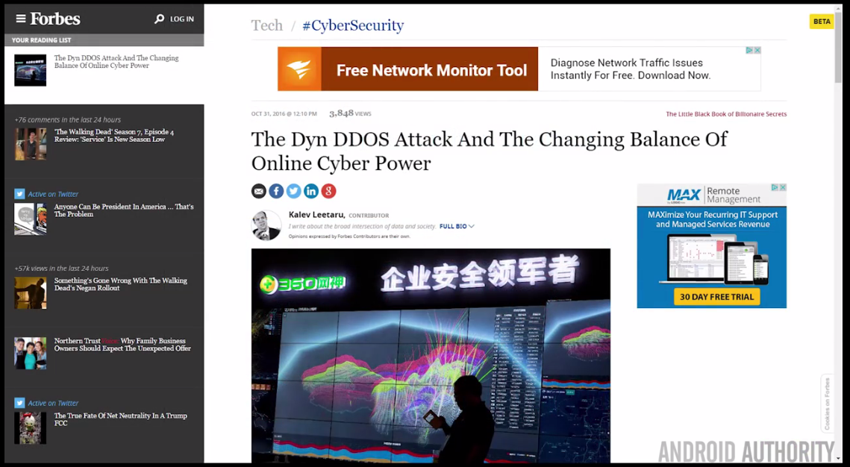
Denial of Service Attack

Slide 12
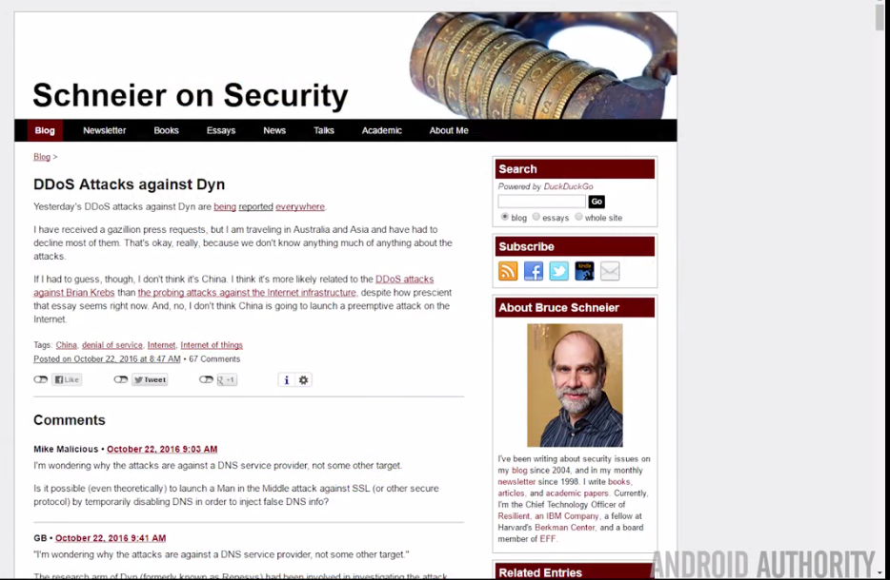
Denial of Service Attack

Slide 13
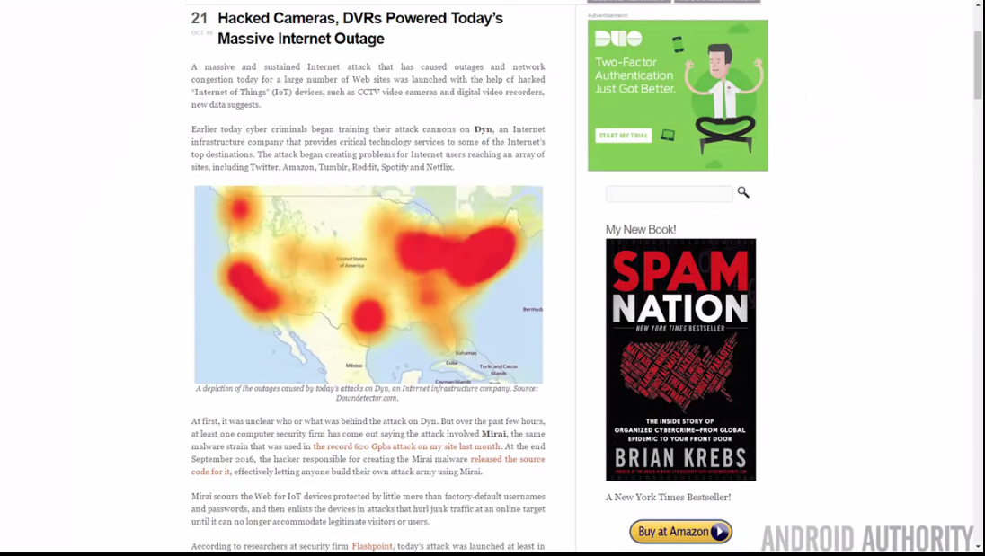
Denial of Service Attack

Slide 14
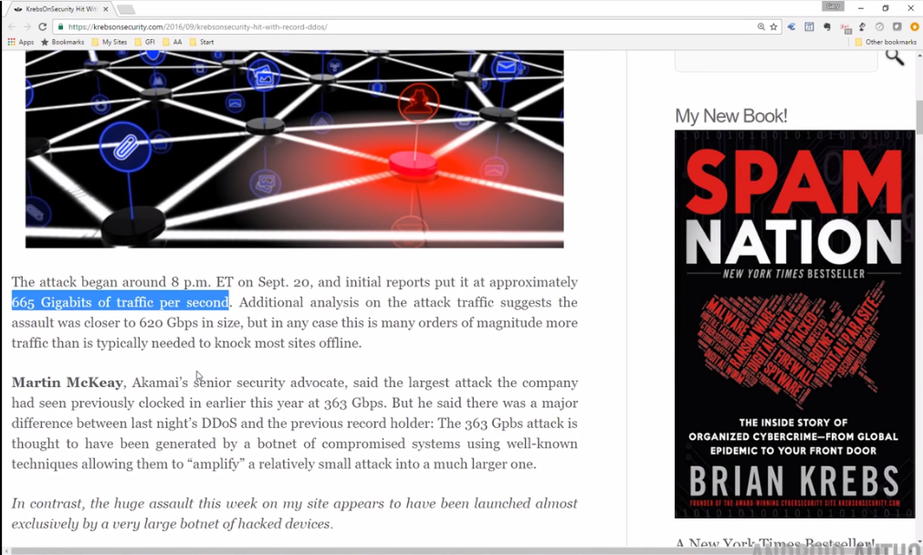
Denial of Service Attack
A denial-of-service (DoS) is any type of attack where the attackers (hackers) attempt to prevent legitimate users from accessing the service. In a DoS attack, the attacker usually sends excessive messages asking the network or server to authenticate requests that have invalid return addresses.

Slide 15
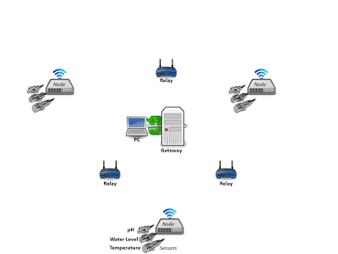
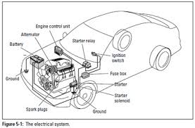
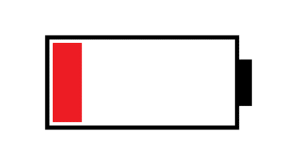
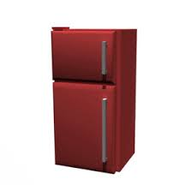
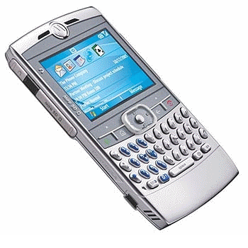
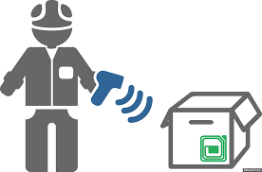
Problems in IoT
CAR ECU system
WSN
Controller
Wireless Connected Home Appliances
Mobile Devices
RFID

Slide 16
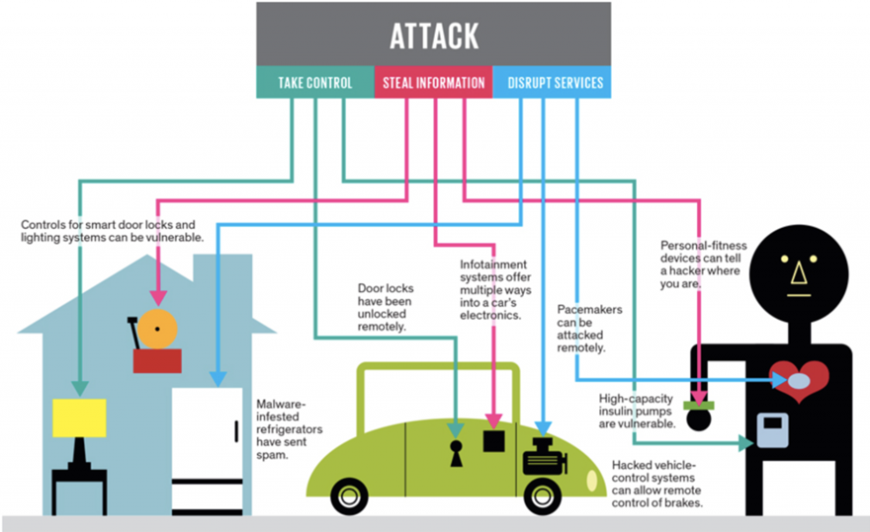
Problems in IoT

Slide 17
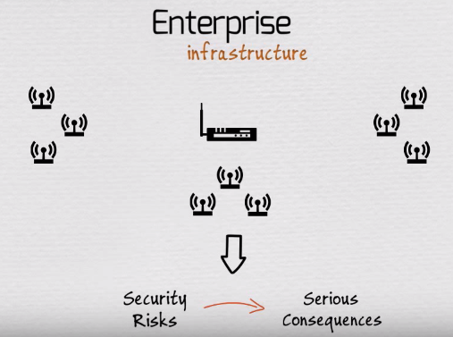

Slide 18
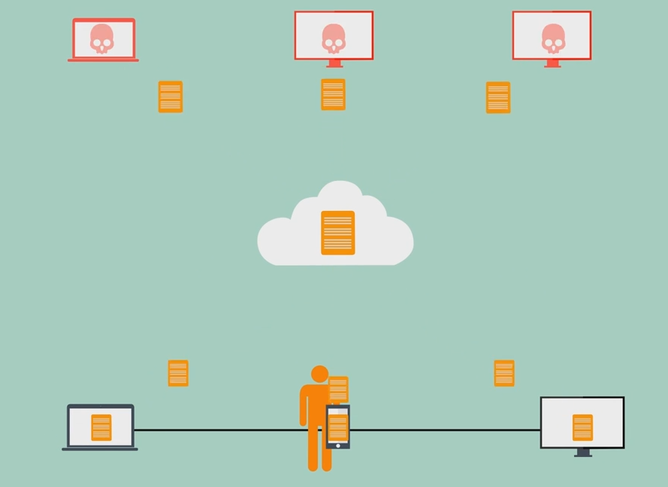
Problems in IoT

Slide 19
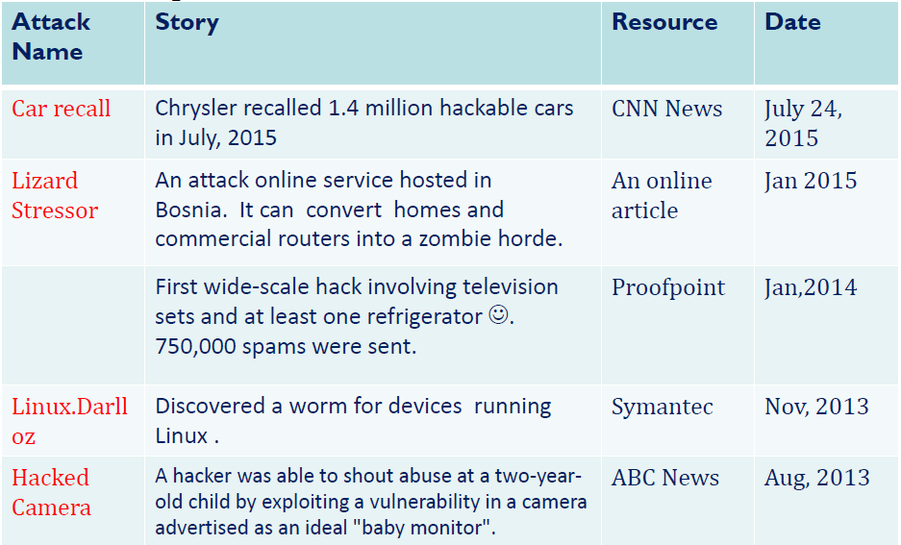
Problems in IoT
Security cases

Slide 20


Problems and Challenges in IoT
Power
Many IoT applications need to run for years over batteries and reduce the overall energy consumption
Many small devices have limited CPU power
Not much processing power for security
Need to look for new encryption scheme with less CPU power
Connectivity
Variety of wired and wireless connectivity standards are required to enable different applications needs
New devices for end point security
New firmware, embedded OS, new software & etc.
It is not possible to support AV on every device.

Slide 21

Problems and Challenges in IoT
Sensing a complex environment
Innovative ways to sense and deliver information from physical world to cloud
Security
Protecting user privacy and manufacturers IP detecting and blocking malicious activity
IoT needs both encryption key management and identity management which may scale into billions
New transport protocols making network security difficult
Much more network traffic for security analysis
Bad news for large enterprises as network security is already complex and cumbersome

Slide 22
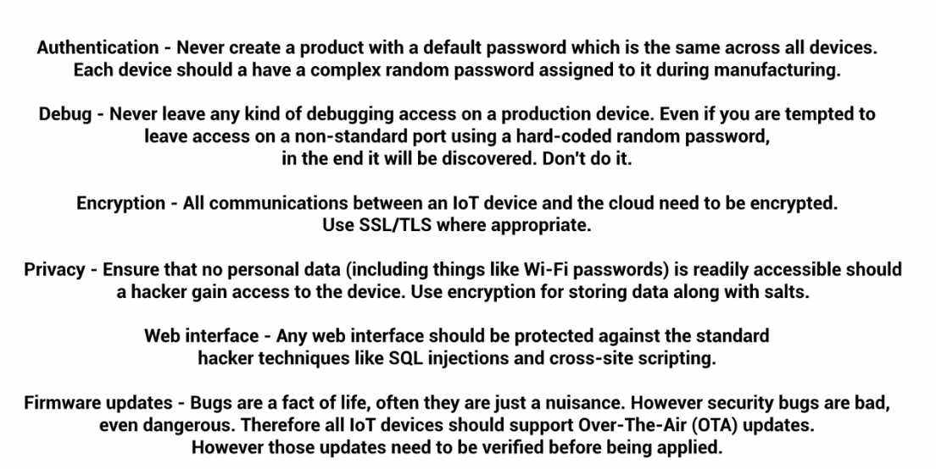

Slide 23
Seven IoT security Risks
Disruption and denial-of-service attacks
Understanding the complexity of vulnerabilities
IoT vulnerability management
Identifying, implementing security controls
Fulfilling the need for security analytics capabilities
Modular hardware and software components
Rapid demand in bandwidth requirement

Slide 24
IoT security
Insecure Web Interface
Insufficient Authentication/ Authorization
Lack of Transport Encryption
Privacy Concerns
Insecure Software/Firmware
Insecure Network services
Insecure Cloud Interface
Insecure Mobile Interface
Insufficient Security Configurability
Poor Physical Security

Slide 25

IoT security Solution
Introduce a new encryption system for providing the security to constrained environment

Slide 26
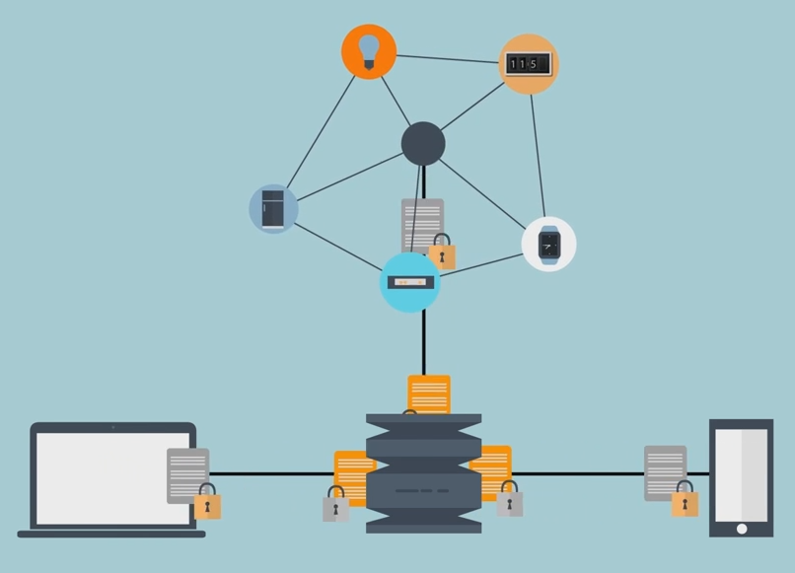
Encryption System

Slide 27
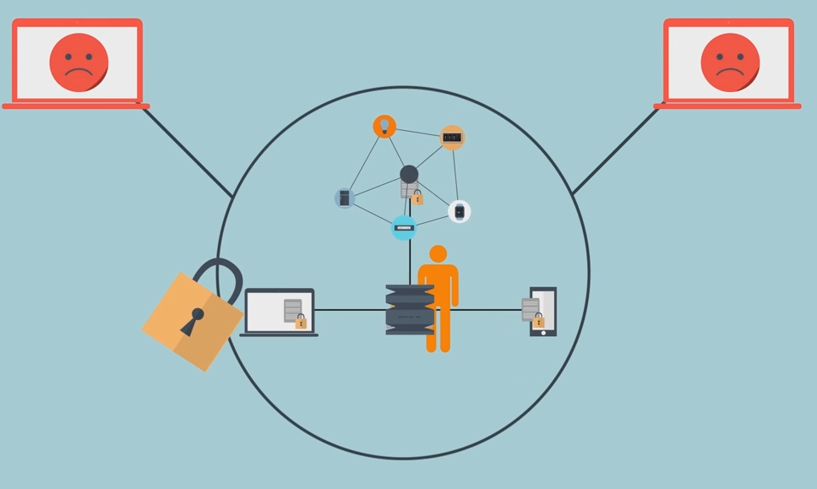
Secured Network

Slide 28
Application Specific
For hardware implementation of RFID tag 10000 GE’s are required.
But for security, only 2000 GE’s are available
Standard algorithm like AES, DES need more than 3000 GE’s for its hardware implementation.
Main aim is to reduce the GE’s less than 2000
Without compromising the Security parameters

Slide 29
Constrains
GE’s
Memory Requirement
Power Consumption
Throughput
Security

Slide 30
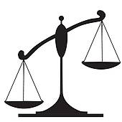
Lightweight Cryptography ?
It endorses algorithms which are best suited for constrained environment
For e.g. RFID Tags, sensors, contactless smart card, health-care devices and so on.
GE’S should be less than 2200.
Lightweight Cryptography
Heavy Security Algorithm

Slide 31
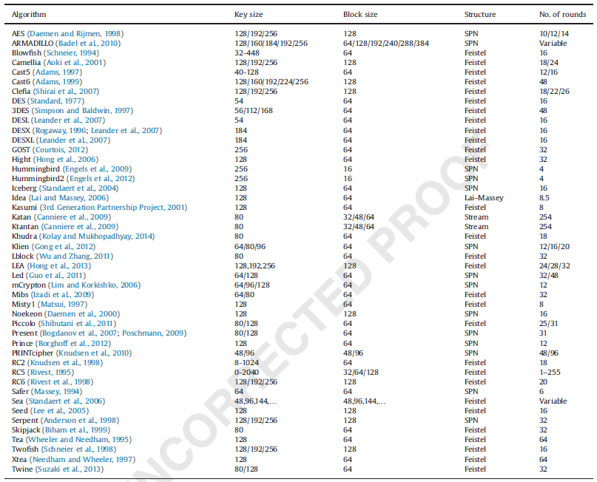
List of ciphers

Slide 32

“Our Contribution”

Slide 33
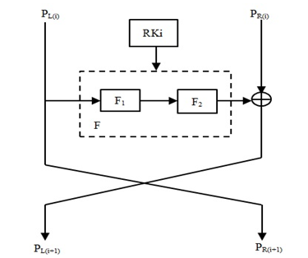
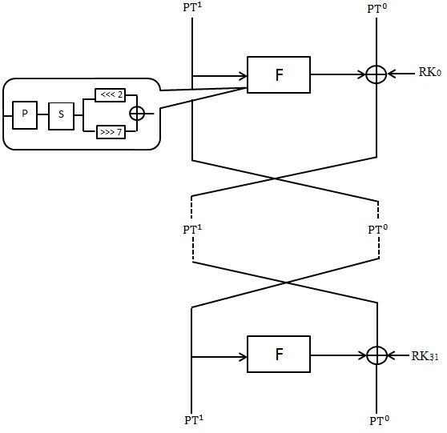
Cipher Designs
MANTRA
GRANULE

Slide 34
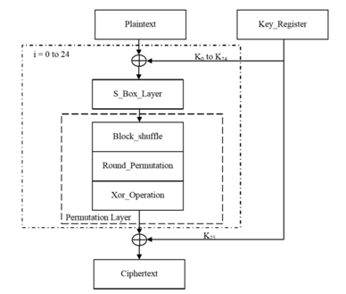
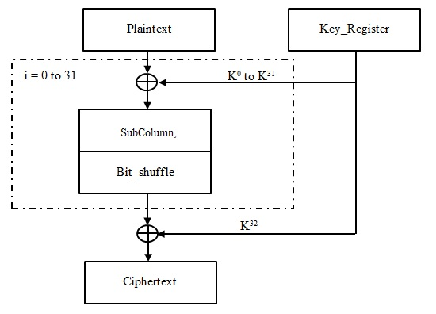
Cipher Designs
PICO
BORON

Slide 35
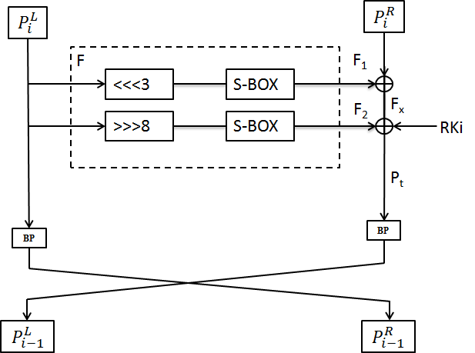
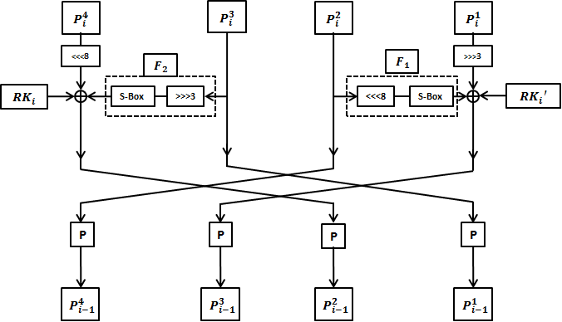
Cipher Designs
ANU
NUX

Slide 36
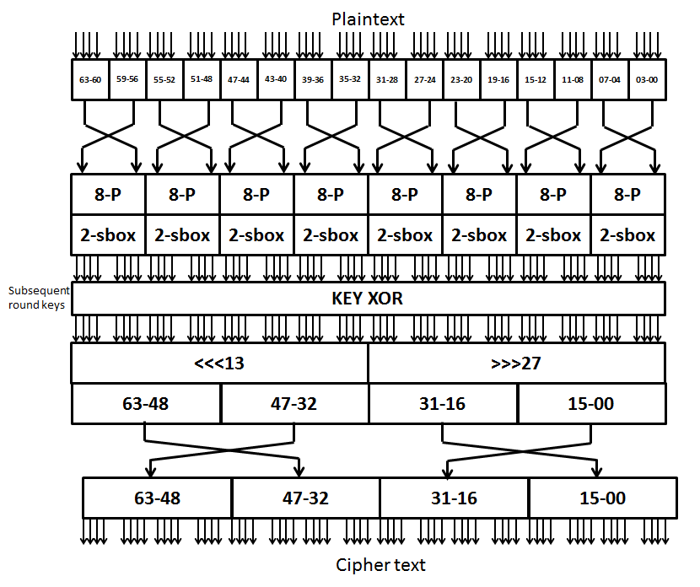
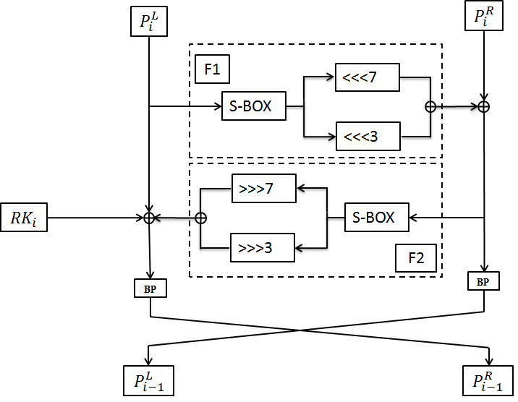
Cipher Designs
RAGHAV
VAYU

Slide 37
Overall GE’s Comparison

Slide 38
Overall foot print area Comparison

Slide 39
Overall Power Comparison

Slide 40
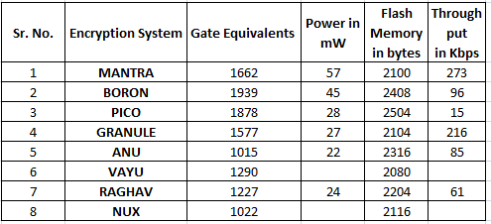
Various Encryption Designs

Slide 41
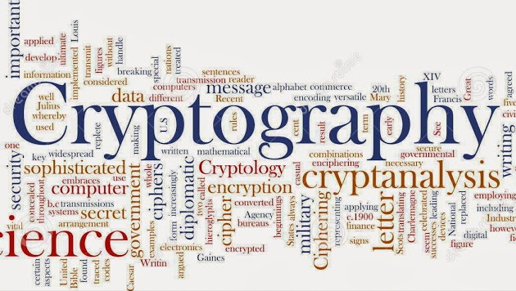
Thank you

